Slide 1
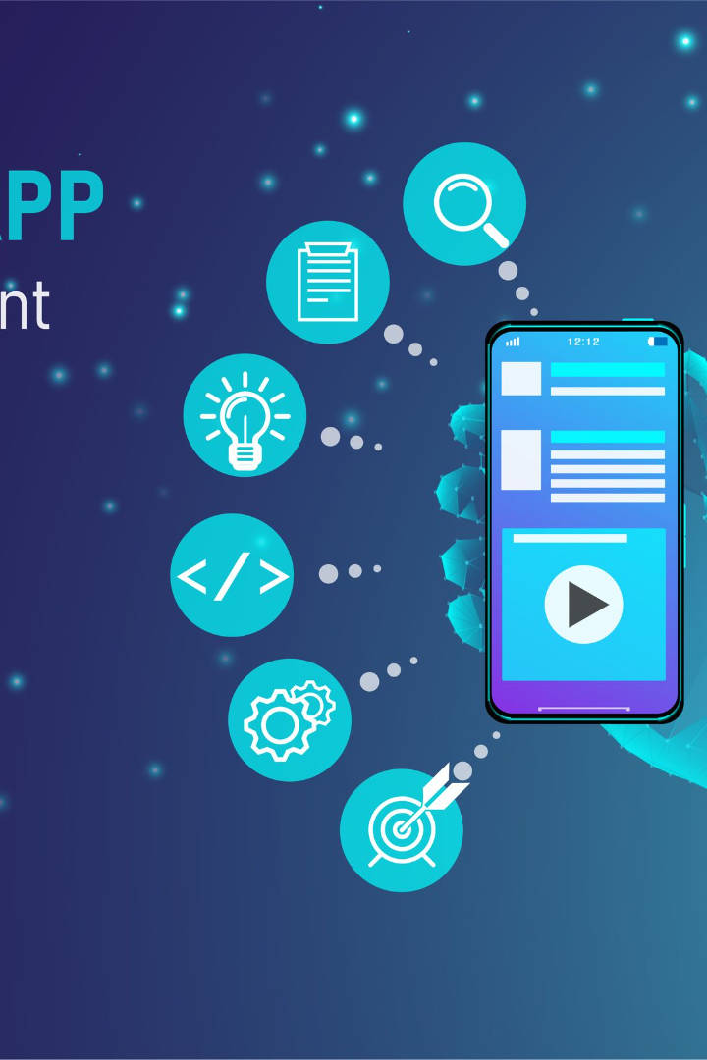
Building the Mobile App
by Hano MJ

Slide 2
Introduction
Overview
Development
Learn about the project's goals and how the mobile app contributes to its success.
Discover the importance of having a mobile app for the project's functionality.
Python
Framework
Explore why Python is the ideal programming language for mobile app development.
Understand the process of selecting the right mobile app development framework.

Slide 3
App Functionality
1
Real-Time Display
2
Raspberry Pi Integration
3
Data Reception & Display
Show parking availability in real-time, giving users up-to-date information.
Explore how the mobile app integrates seamlessly with the Raspberry Pi.
Learn how the app receives and effectively displays parking availability data.

Slide 4
Development of the Mobile App
1
Design
Create wireframes and UI design to ensure an intuitive user experience.
Implementation
2
Use Python and the chosen framework to bring the app to life.
3
Testing
Conduct thorough testing to ensure the app's functionality and performance.
Deployment
4
Deploy the app to the desired platforms, making it available to users.

Slide 5
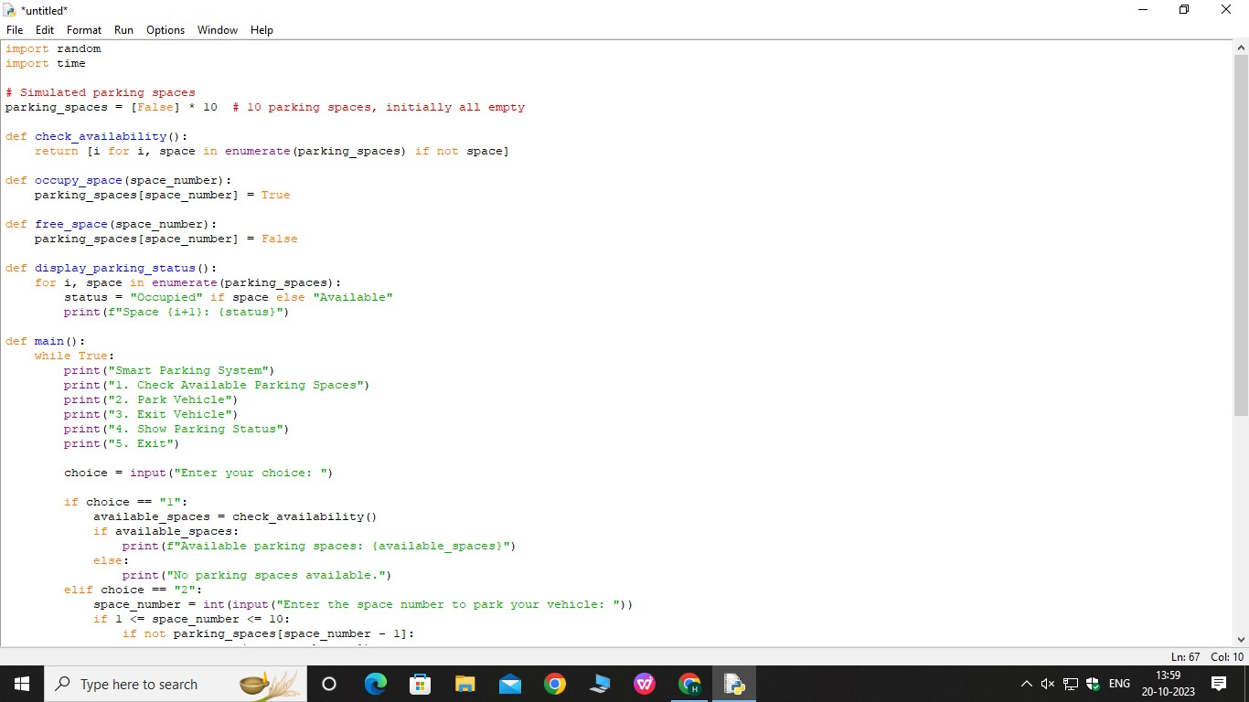
python script continuation on real time smart parking app

Slide 6
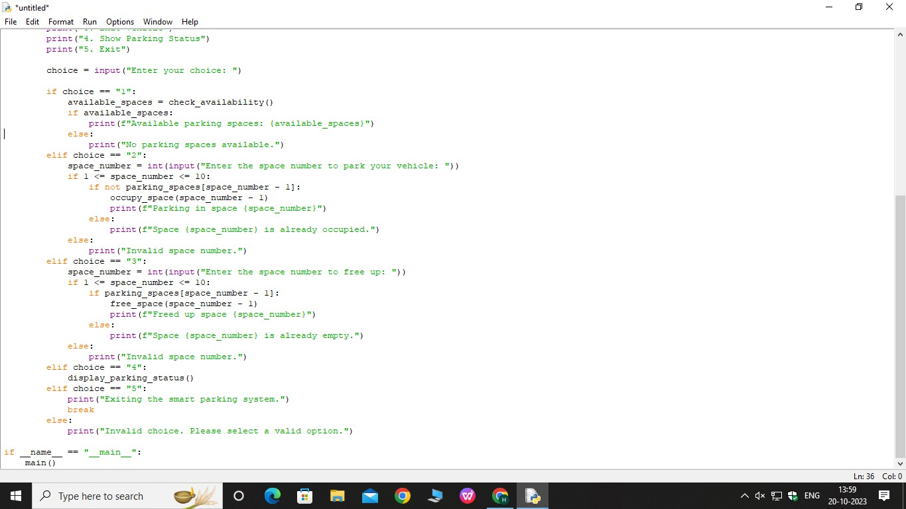

Slide 7
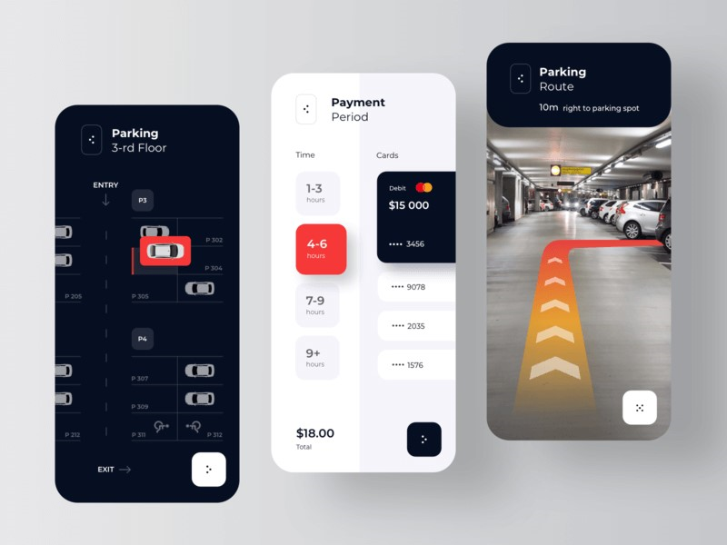
Function of the smart parking app

Slide 8
Conclusion
hence the real time smart parking app is developed and is able to receive and display parking space availability data from rasberry pi.

